Slide 1

Predicting Team Performance
based on Player Statistics
Neelan Muthurajah

Slide 2

Objective/Purpose
Project analyzes the correlation between individual player statistics and team performance
Develop a linear regression model that can be leveraged in forecasting all 30 NBA teams 2016-2017 regular season performance based on common and advanced player statistics
Questions Considered:
How to measure team performance
Training and test datasets to use
KPI’s to include

Slide 3
Questions Considered
Measuring Team Performance
Win Ratio (Wins/82) will be used to measure team performance (Target Variable)
Training and Test Datasets
Datasets obtained from Basketball-Reference.com and ESPN.com
KPI’s to Include
Player statistics recorded via boxscores
Includes common statistics such as rebounds, points, assists, blocks, turnovers, field goal % etc.
Advancement in NBA statistics allowed for more robust and indicative metrics for a players contribution to their respective team –Include PER, BPM, Plus/Minus, VORP, Win Shares
These metrics are adjusted for different styles of play
Standardized across the NBA to allow for a fair comparison between players
Combination of various common NBA metrics are used in determining these advanced statistics

Slide 4

Hollinger’s PER
Player Efficiency Rating (PER) was developed by John Hollinger
All in one basketball rating- attempts to translate all a players contributions into a single number
Per minute performance metric and adjusted for team pace
Incorporates a players accomplishments such as field goals, free throws, 3-pointers, rebounds, blocks and steals as well as negative ones such as missed shots, turnovers and personal fouls

Slide 5
Literature Review
Many others have asked a similar question
However these papers lacked the use of all available metrics
One report only focused on the relationship between win % and PER
Second report focused on relationship between win % and common NBA statistics
The goal of this project is to incorporate both sets of data

Slide 6
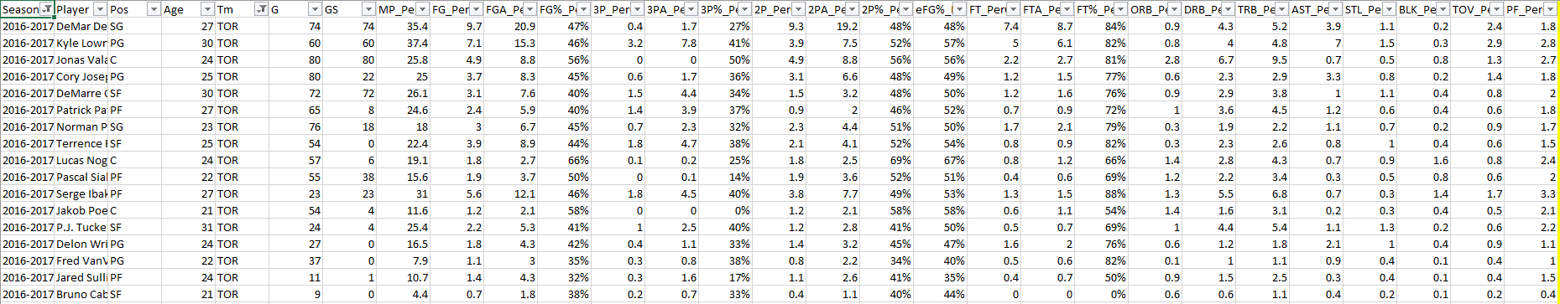
Experimental Design
Data was obtained from Basketball-Reference.com and ESPN.com for the past eight seasons
Data was available in csv format which allowed for easy data retrieval
For common NBA statistics such as points, assists and rebounds, per 36 minute rates were used to standardize all players
ILLUSTRATIVE PURPOSES

Slide 7
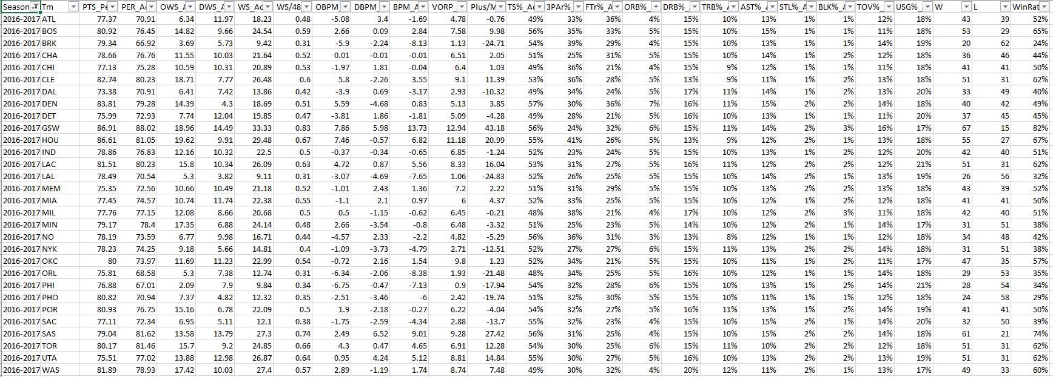
Experimental Design Continued
Data was aggregated on a per team basis in R in order to create simple regressions, correlations, scatterplots and cross validation between the different predictor variables and Win Ratio
More weighting was placed on a player based on % of minutes played for that team
ILLUSTRATIVE PURPOSES

Slide 8
Initial Results- Exploratory Analysis
Using a subset of data (Season results from 2009-2010) I visualized early relationships between predictor variables and Win Ratio
Correlation matrix assisted in identifying three variables that had a strong correlation with Win Ratio
Independent Variable | Win Ratio
PER_Advanced | 0.84
Plus/Minus_Per36Min | 0.94
BPM_Advanced | 0.97
Independent Variable | Win Ratio
PER_Advanced | 0.84
Plus/Minus_Per36Min | 0.94
BPM_Advanced | 0.97
*Figure 1: Pearson Correlation between Independent variables and Win Ratio

Slide 9
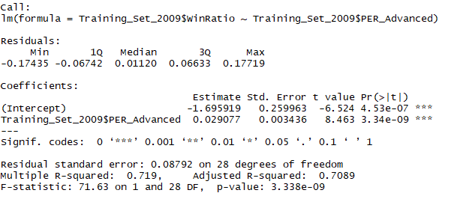
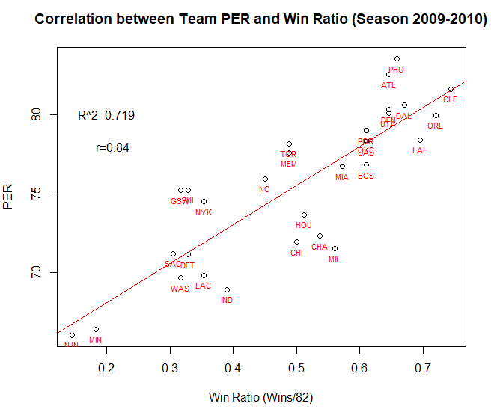
Initial Results- Team PER
Linear relationship between team PER and win ratio. Indicates teams with a higher PER value perform better than low PER teams. High adjusted R-squared value indicates model fits data well. Replication yielded similar results compared to Literature Review paper.
Figure 2: Scatterplot of Team Win Ratio versus Team PER for 2009 to 2010 NBA Season

Slide 10
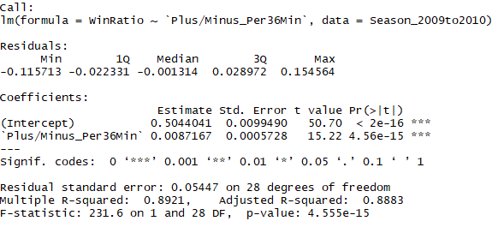
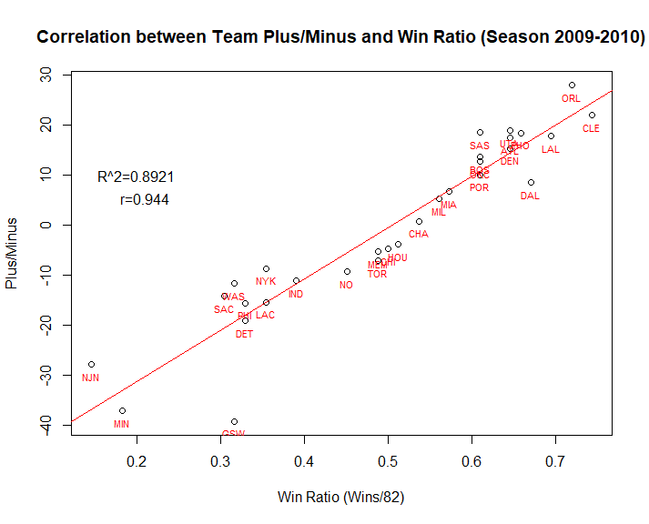
Initial Results- Team Plus/Minus
Linear relationship between team Plus/Minus and Win Ratio. Indicates teams with a higher Plus/Minus value perform better than low Plus/Minus teams. The linear model yields a R² result with an adjusted R² of 0.8883, making it an even stronger indicator of Win Ratio than Team PER.
Figure 4: Scatterplot of Team Win Ratio versus Team Plus/Minus for 2009 to 2010 NBA Season

Slide 11
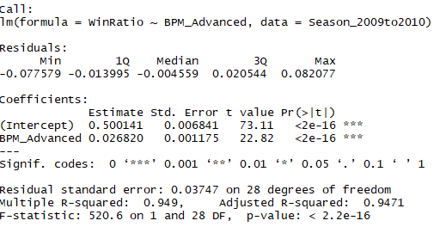
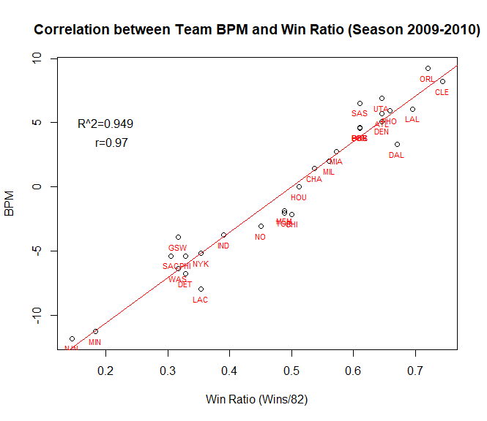
Initial Results- Team BPM
Based on the summary statistics, the linear model yields a strong R² result with an adjusted R² of 0.9471. The significant F-statistic from the Wald test (F-Statistic significantly greater than 1) further confirms that the linear model fits the data well and that there is a relationship between BPM and Win Ratio. In addition, the results of this test indicate that Team BPM has a stronger relationship with Win Ratio than either Team PER or Team Plus/Minus.
Figure 3: Scatterplot of Team Win Ratio versus Team BPM for 2009 to 2010 NBA Season

Slide 12
Initial Conclusions
Exploratory analysis indicated that advanced NBA metrics are better indicators than common metrics
Advanced NBA metrics consider many common metrics when computing a players overall skill level/value to their team
Although literature review report indicated a strong relationship between Team PER and Win Ratio, BPM and Plus/Minus display an even stronger relationship to team performance

Slide 13

Assessing for Multicollinearity
Used the caret package in identifying highly correlated variables
The code indicated that the following variables were correlated with one another
Rather than remove all 13, I kept variables not correlated with one another. Following variables were kept in the dataset: FGA_Per36Min, ThreeP_Per36Min, TwoP_Per36Min, TRB_Per36Min, PTS_Per36Min, PER_Advanced, BPM_Advanced and TRBPercent_Advanced
Decide to remove Win Share attributes considering this metric uses Wins at the end of the season to calculate Win Shares

Slide 14

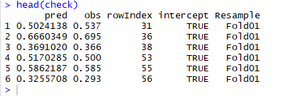
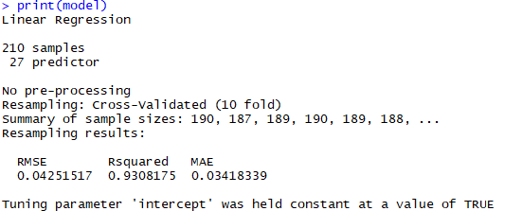
Cross Validation
Important to test model performance against different subsets of data. Using k-fold cross validation I rigorously trained my model using k-1 data splices.
Results of cross validation using caret package:
Results:
Mean Absolute Error (MAE) and Root mean squared error (RMSE) are two of the most common metrics used to measure accuracy for continuous variables.
Root Mean Square Error (RMSE) is the standard deviation of residuals (prediction errors).
Mean Absolute Error (MAE) measures the average magnitude of the errors in a set of predictions
Both MAE and RMSE are low indicating the model does a good job in predicting Win Ratio. It also indicates better fit of the regression model.
Figure 4: Predicted Vs. Observed Results of Cross Validation
*Cross validation done on season metrics from 2009 to 2015. Season 2016-2017 was removed to be used as true test data.

Slide 15
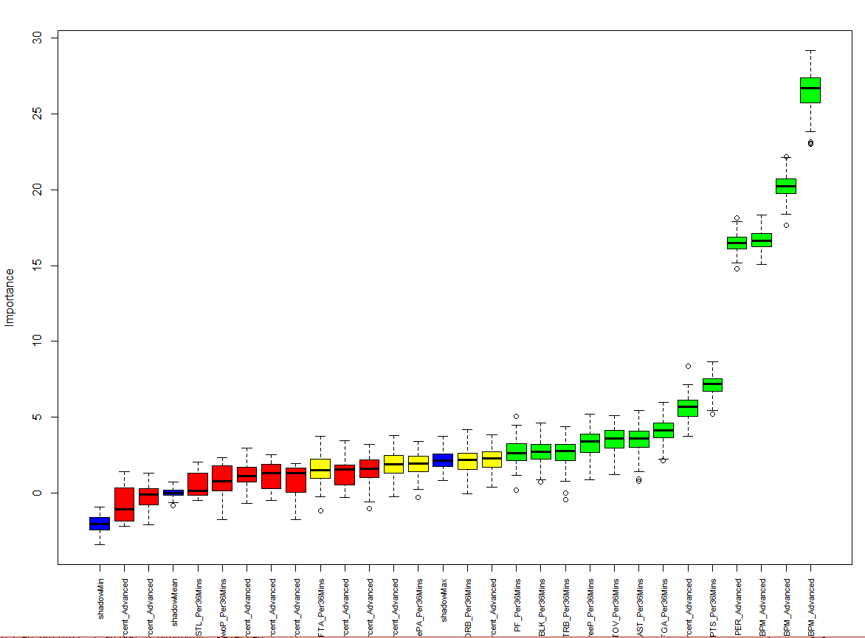
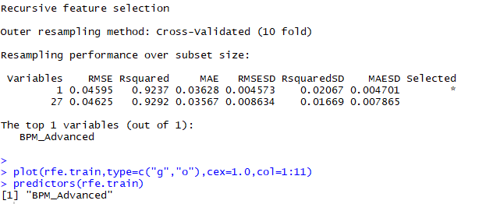
Feature Selection
Important to utilize feature selection techniques to avoid overfitting. Used Boruta and caret package for feature selection.
Results of Caret Package:
Results of Boruta Package:
Figure 5: Important Features based on Boruta Package
Results:
Results of only BPM indicated that the variable was significant and resulted in an R² of 0.93
Results of Boruta package using the top 5 variables resulted in an R² of 0.94

Slide 16
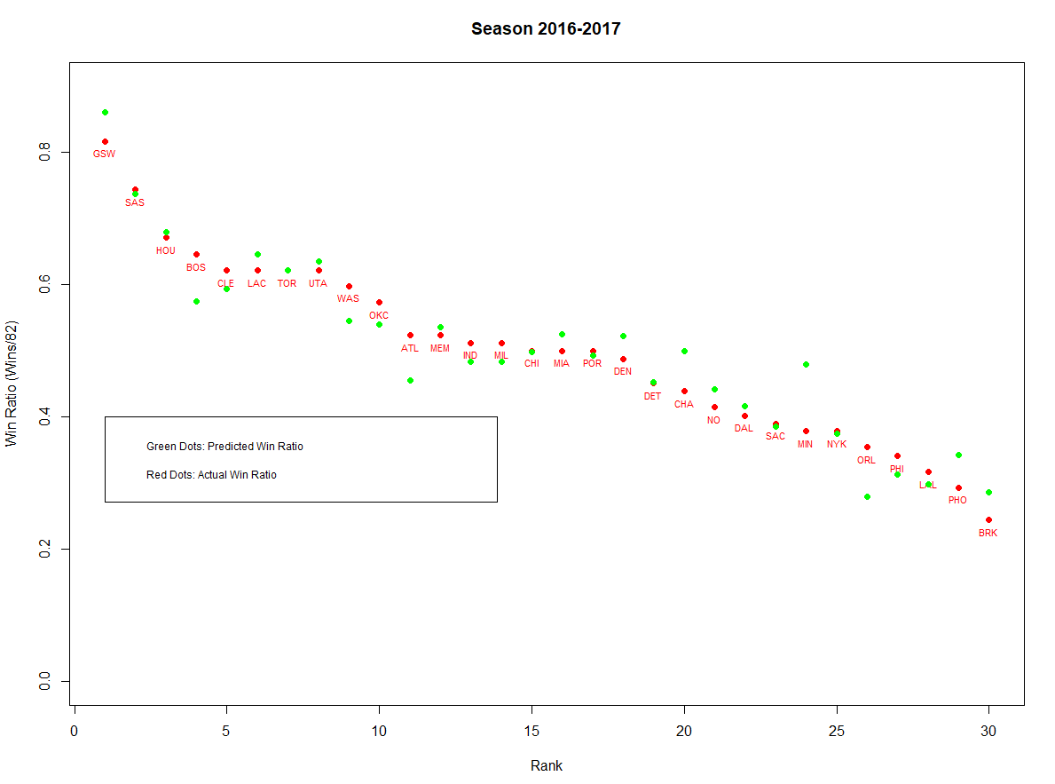
Evaluation on Test Data
Using season data from 2016-2017 I utilized the BPM model to assess win ratio
Results of “True” Test Data:
Actual Win Ratio | Predictive Win Ratio
GSW | GSW
SAS | SAS
HOU | HOU
BOS | LAC
CLE | UTA
LAC | TOR
TOR | CLE
UTA | BOS
Actual Win Ratio | Predictive Win Ratio
GSW | GSW
SAS | SAS
HOU | HOU
BOS | LAC
CLE | UTA
LAC | TOR
TOR | CLE
UTA | BOS
Figure 6: Top 10 Teams of the 2016-2017 NBA Season based on Actual Win Ratio Vs. Predictive Win Ratio
Results:
Box Plus/Minus predicted Win Ratio accurately based on results of RMSE and MAE. High R² also indicate that BPM explains much of the variation in Win Ratio. Top 10 teams in the league based on Win Ratio are identical, just in a different order.

Slide 17
Conclusions
BPM is a valid predictor of Win Ratio
Replicated study highlighted key findings in previous literature review reports but went one step further in identifying a better variable for predicting Win Ratio
Advanced NBA metrics consider many common metrics when computing a players overall skill level/value to their team and are better to utilize than common metrics
Previous studies on this topic lacked the use of all available variables. This study utilized all available metrics and therefore identified a key variable (BPM)that was not leveraged in either study indicated in the literature review section

